Slide 1


Local Connections, national Impact:
The role of business schools in driving SME success

Slide 2
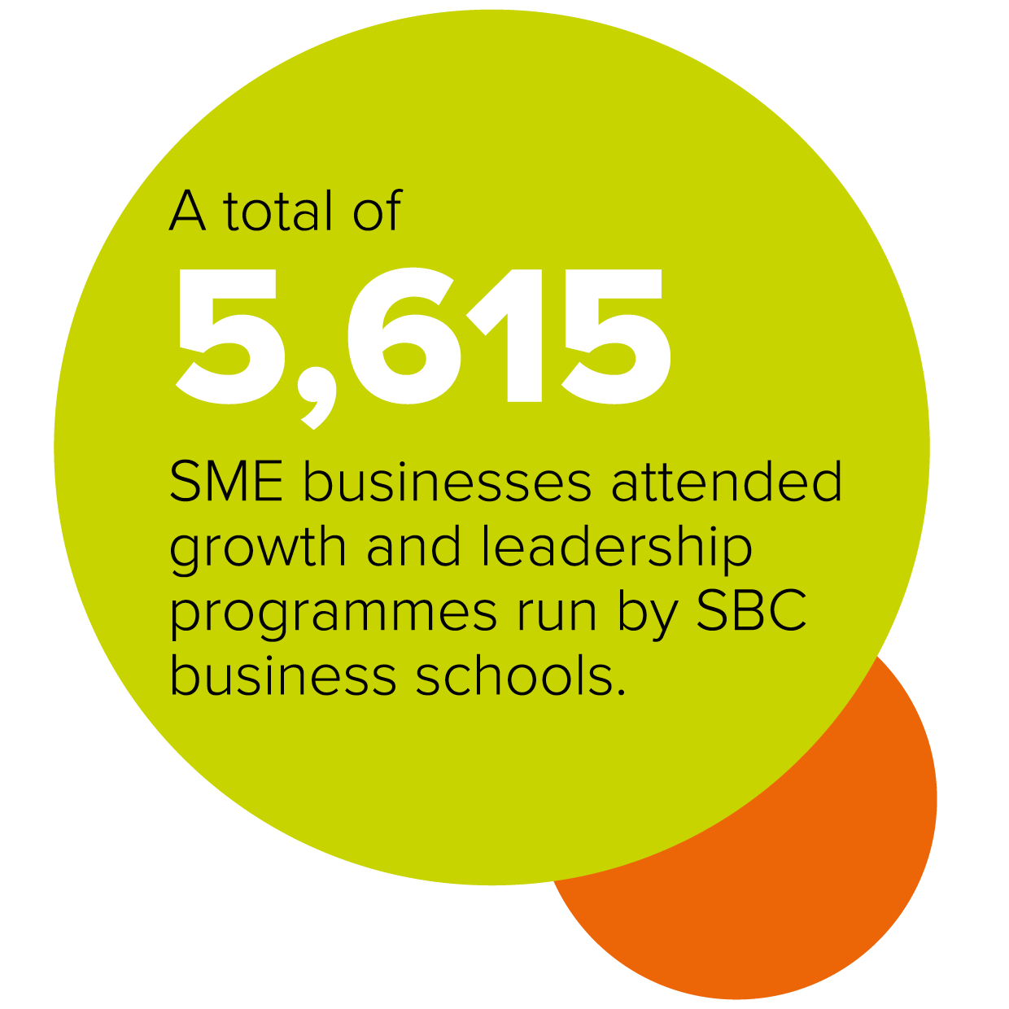
Business schools are reaching business leaders at scale
8,068 individuals from SME businesses participated in these programmes

Slide 3
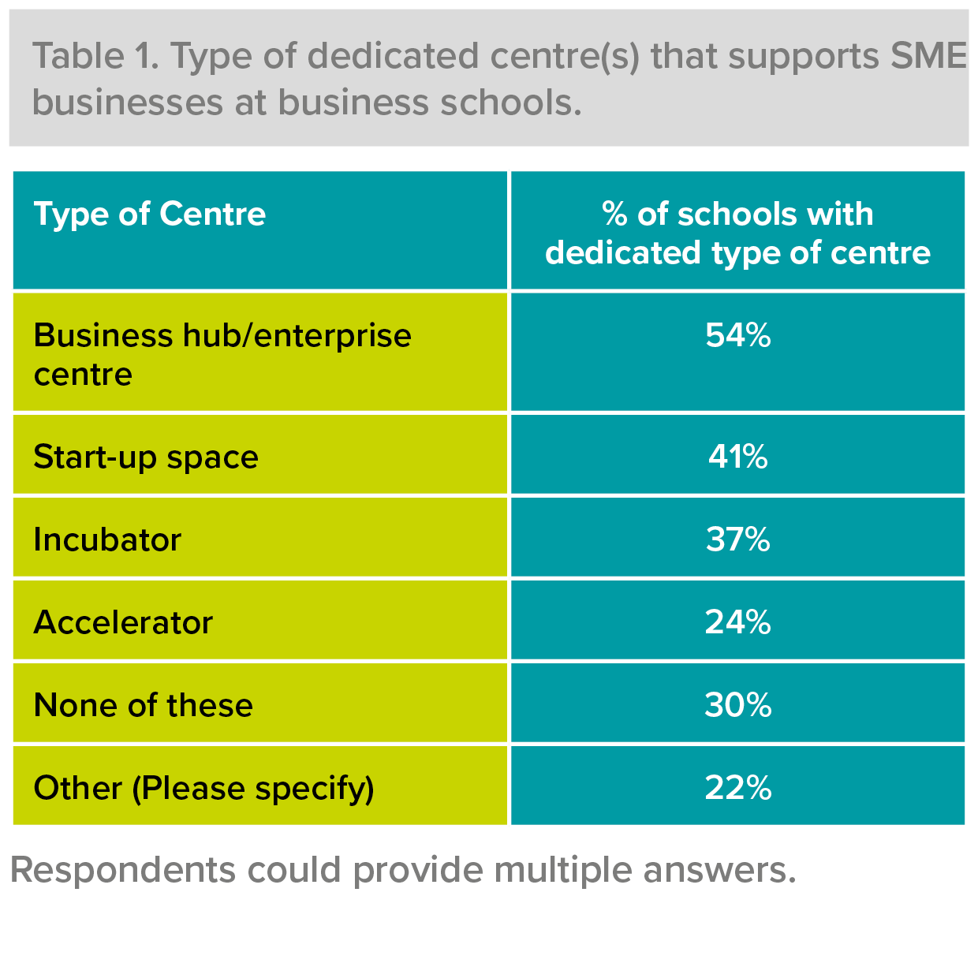
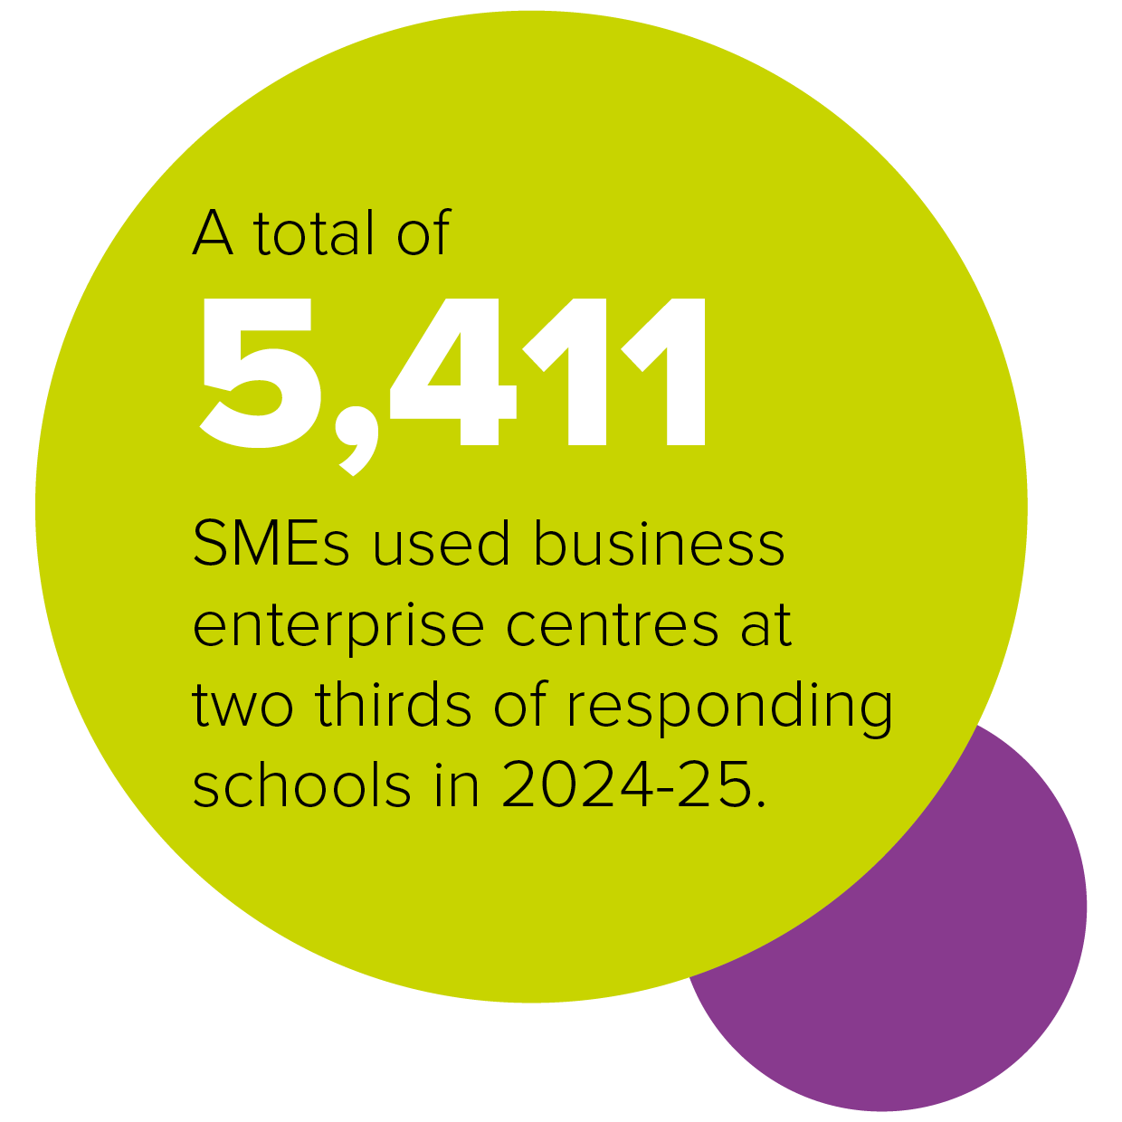
A visible
front door

Slide 4

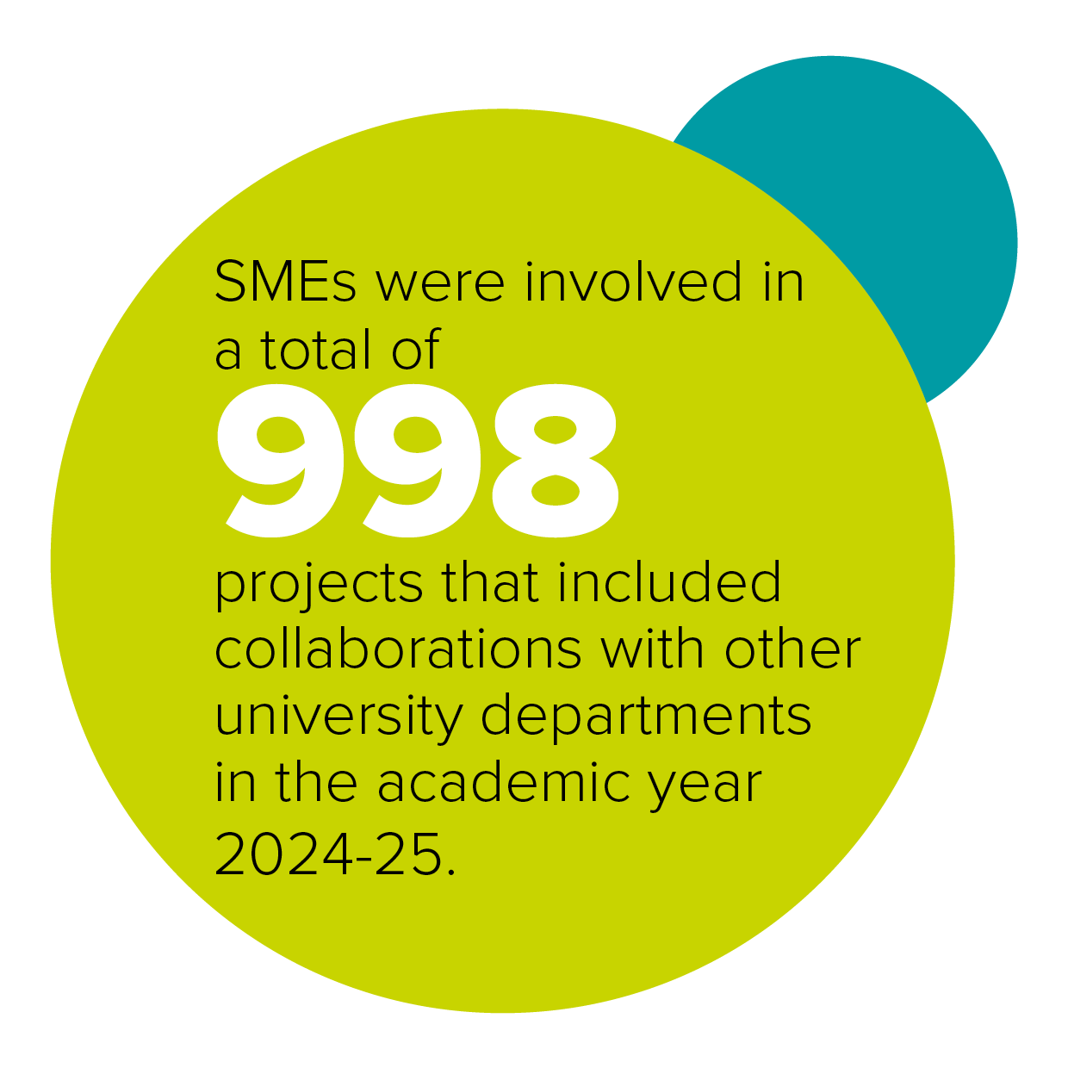
Bridging academia and business

Slide 5
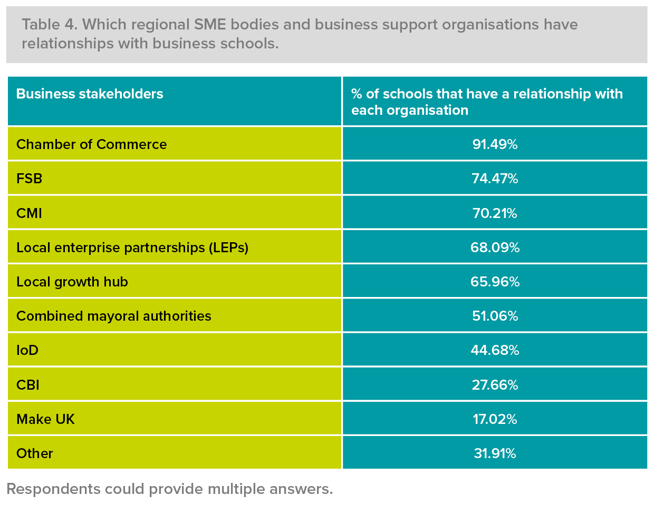
Strong ties to regional economic networks

Slide 6

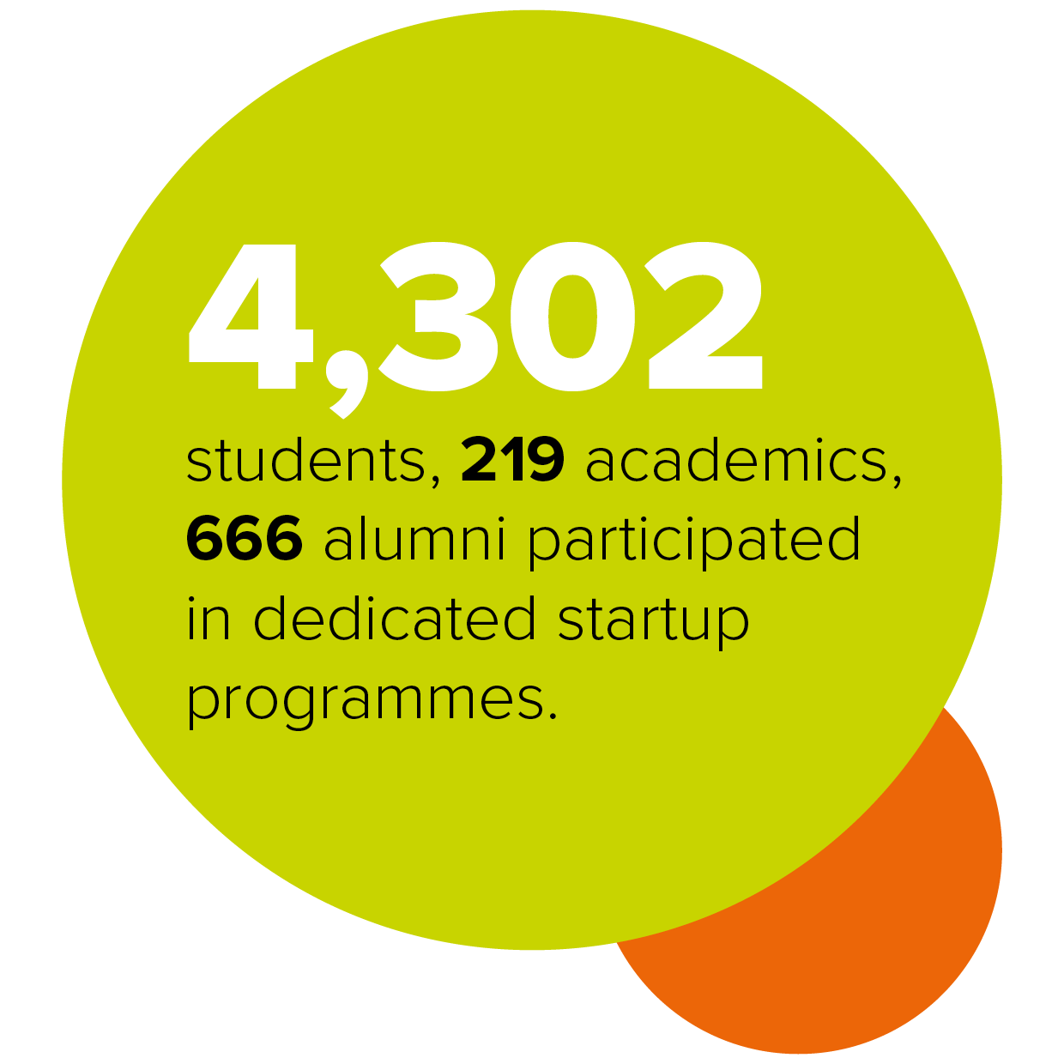

Supporting entrepreneurs of the future

Slide 7

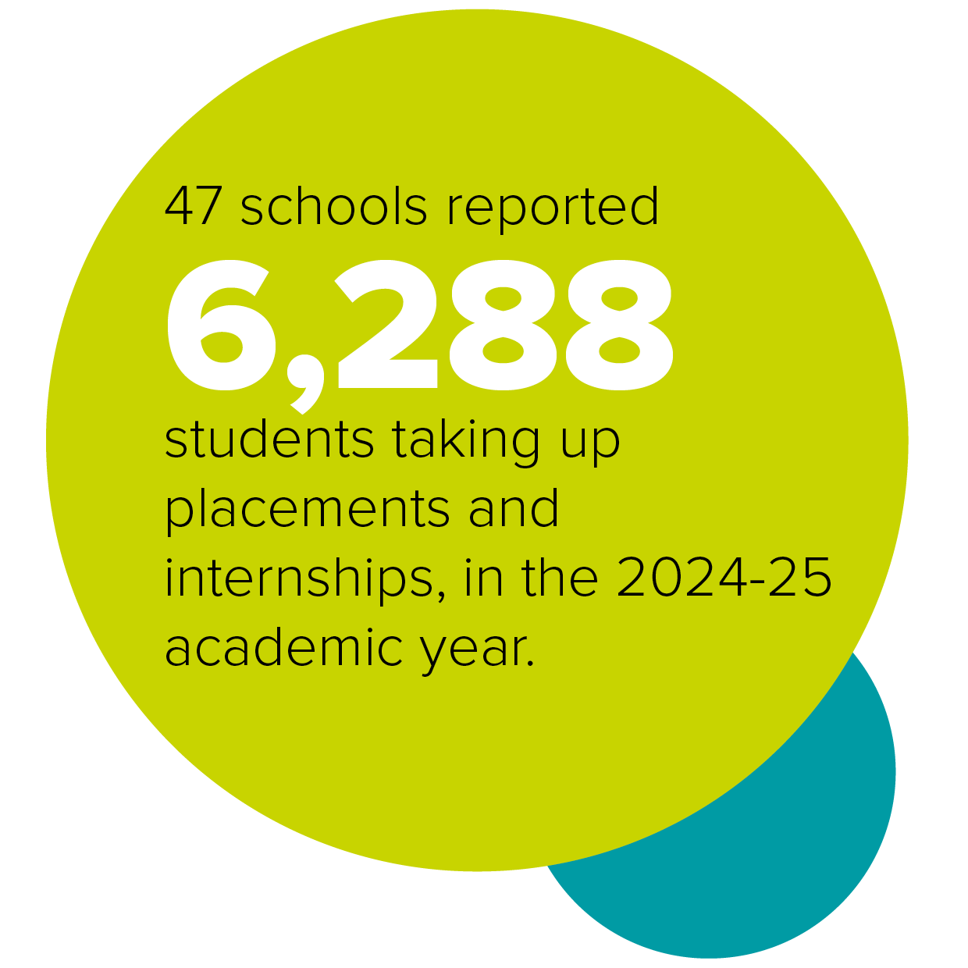

Real-world learning

Slide 8
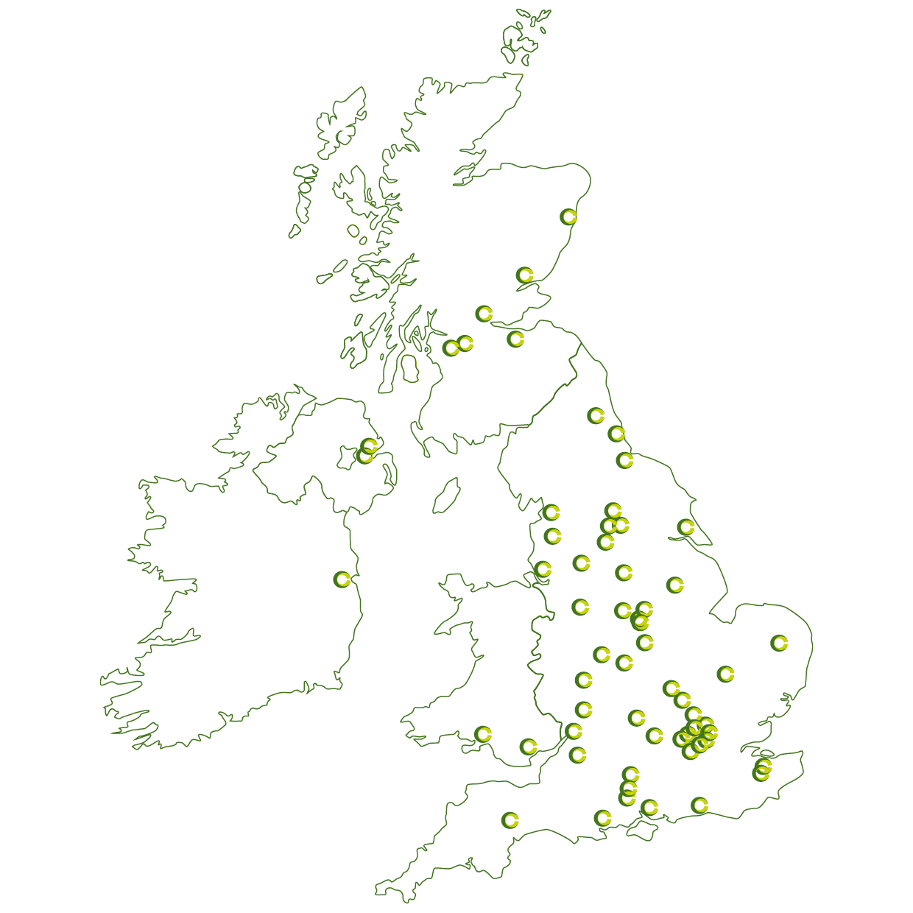

There are 70 accredited schools within easy reach of SMEs in every region and nation across the UK, and two trailblazing international business schools in Ireland and Australia.

